Slide 1
Installing MySQL
Installing MySQL
Go to MySQL.com
Check Downloads

Slide 2
You will need to scroll down to: MySQL Community Edition
Click on it

Slide 3
You will download:
MySQL Workbench (GPL)
(Current Generally Available Release: 6.3.9)
MySQL Workbench is a next-generation visual database design application that can be used to efficiently design, manage and document database schemata. It is available as both, open source and commercial editions.
DOWNLOAD
MySQL Connectors
MySQL offers standard database driver connectivity for using MySQL with applications and tools that are compatible with industry standards ODBC and JDBC
DOWNLOAD
MySQL on Windows (Installer & Tools)
(Current Generally Available Release: 5.7.19)
MySQL provides you with a suite of tools for developing and managing MySQL-based business critical applications on Windows.
DOWNLOAD

Slide 4
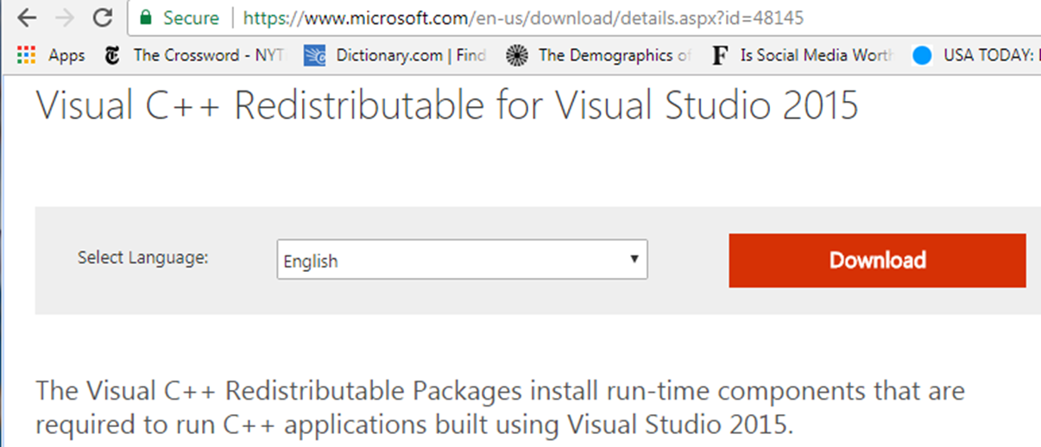
HOWEVER -- This might not work!!
If you notice that your database connections didn’t load, will need to download another package found Here:
After you install this package, you will need to restart the operating system and then reinstall MySql

Slide 5
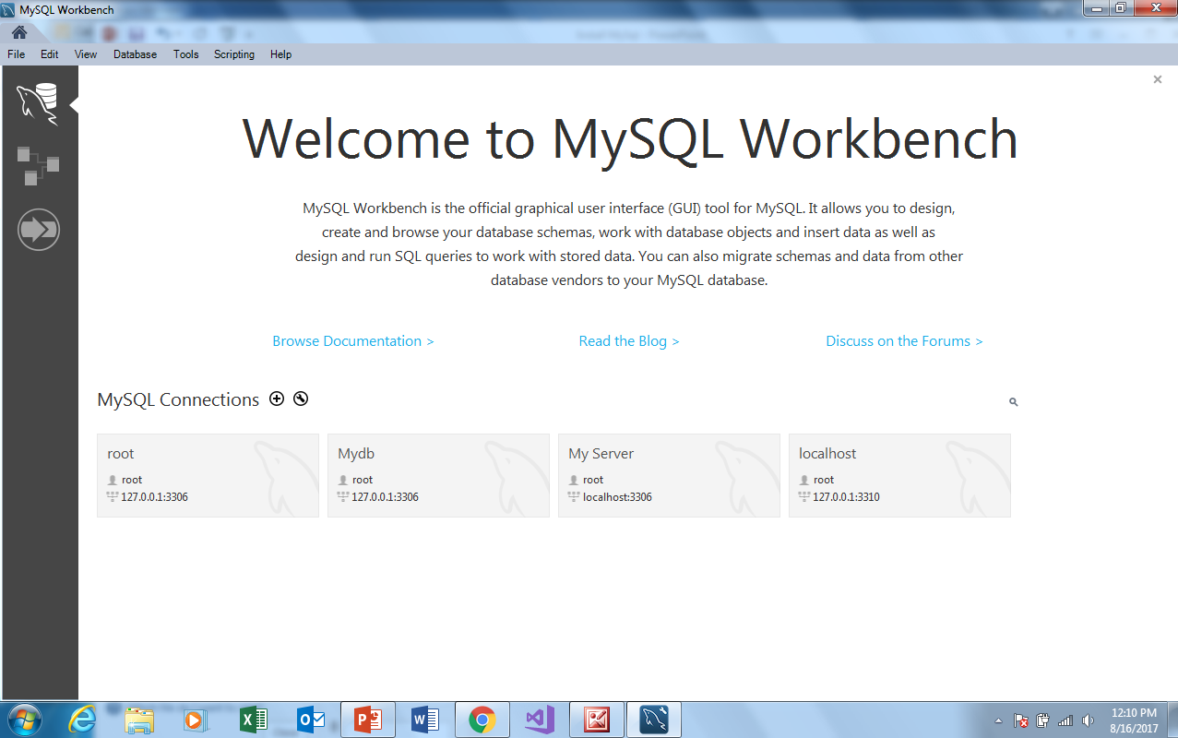
If you now open the Workbench and it looks something like this you should be set

